Slide 1
Fetching and Caching Data

Slide 2
Objectives
Overview of Asynchronous Operations in ReactJS
Promise and Async/Await
Introduction to Fetch/Axios
Using Promise, Fetch, and Axios in ReactJS

Slide 3
Overview of Asynchronous Operations in ReactJS
Why Asynchronous Operations?
ReactJS apps often fetch data from servers (e.g., APIs) to render dynamic UIs.
Asynchronous operations allow non-blocking code execution, improving user experience.
Key Tools:
Promise: Handles asynchronous operations and their results.Fetch: Browser-native API for making HTTP requests.
Axios: A popular third-party library for HTTP requests.
Context: Used in client-side rendering (CSR) to fetch data from servers in ReactJS apps.

Slide 4
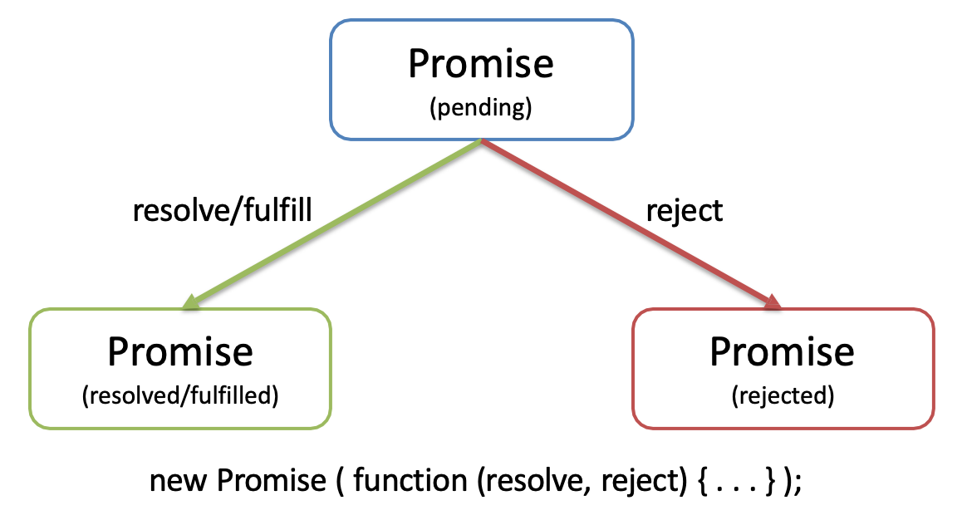
Promise and Async/Await
Promise is a mechanism that supports asynchronous computation
It lets you write asynchronous code in a synchronous way, but instead of returning the final value, it returns a “promise” to return the final value at some point.
Promises can be in one of three states:
Pending: This is the initial state of a promise.
Fulfilled: The operation was completed successfully.
Rejected: The operation failed.

Slide 5
Key Features of Promise
Chaining: Use .then() for success and .catch() for errors.
Async/Await: Syntactic sugar for Promises, making code more readable.
Promise Methods:
Promise.all(): Waits for multiple Promises to resolve.
Promise.race(): Returns the first resolved/rejected Promise.
Use Case: Fetching multiple API endpoints concurrently in a ReactJS app.
myPromise
.then(data => console.log(data))
.catch(error => console.error(error));
async function getData() {
try {
const result = await myPromise;
console.log(result);
} catch (error) {
console.error(error);
}
}

Slide 6
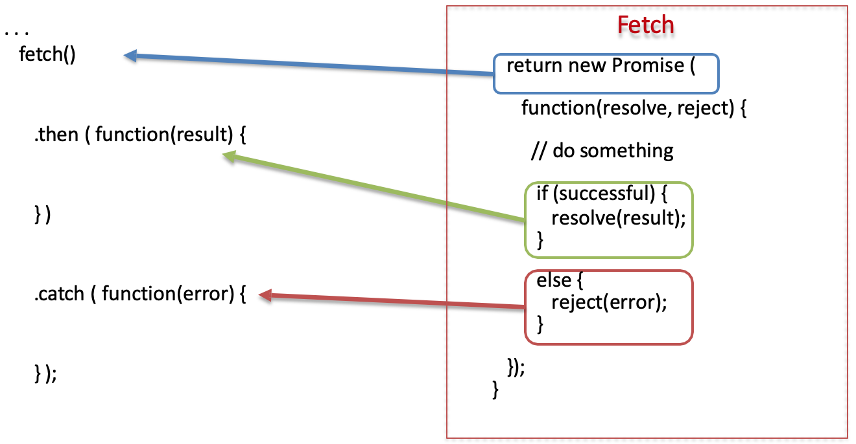
Promise Example

Slide 7
Why Promises?
Solves the callback hell (heavily nested callback code) problem
Promises can be chained
Can immediately return:
Promise.resolve(result)
Promise.reject(error)
const fetchData = () => {
return new Promise((resolve, reject) => {
setTimeout(() => {
const data = "Data has been loaded";
const error = null;
if (data) {
resolve(data); // Resolve Promise with data
} else {
reject(error); // Promise rejected with error
}
}, 2000); // Simulate loading time
});
};
Notes:
Sử dụng Promise giúp giải quyết vấn đề "callback hell" (mã callback lồng sâu) như sau:
Promises có thể được gắn chuỗi (chained) với nhau. Bạn có thể truyền kết quả của một promise cho promise tiếp theo.
Promise có thể trả về ngay:
Promise.resolve(result) để trả về kết quả thành công.
Promise.reject(error) để trả về lỗi.
Chained là việc gắn liền, liên kết nhiều promise với nhau.
Chẳng hạn như ví dụ trên, ta có:
func1() trả về promise.
Sau đó ta dùng .then() để thực thi hàm func2(), hàm này cũng trả về một promise.
Tiếp tục ta dùng .then() nữa để thực thi func3(), ...

Slide 8
Convert from Function to Promise
function userCheck(username, password, callback){
db.verifyUser(username, password, (error, userInfo) => {
if (error) {
callback(error)
}else{
db.getRoles(username, (error, roles) => {
if (error){
callback(error)
}else {
db.logAccess(username, (error) => {
if (error){
callback(error);
}else{
callback(null, userInfo, roles);
}
})
}
})
}
})
};
userCheck(username, password)
.then(({ userInfo, roles }) => {
// Process when the result is successful
console.log("User Info:", userInfo);
console.log("Roles:", roles);
})
.catch((error) => {
// Handle when an error occurs
console.error("Error:", error);
});

Slide 9
What Async/Await?
Async/await is a JavaScript syntax that makes handling asynchronous functions easier to read and write. It uses the async and await keywords to create synchronous processing from asynchronous functions.
When a function is marked as async, it returns a Promise and allows the use of the await keyword within it to wait until a Promise is resolved or rejected.

Slide 10
Introduction to Fetch
What is Fetch?
A modern, browser-native API for making HTTP requests (GET, POST, etc.).
Returns a Promise that resolves to the response object.
Key Features:
Supports all HTTP methods (GET, POST, PUT, DELETE).
Handles JSON, text, and other response types.
Lightweight, no external dependencies.
fetch('https://api.example.com/data')
.then(response => response.json())
.then(data => console.log(data))
.catch(error => console.error(error));

Slide 11
Key Features of Fetch
Response Handling:
response.json(): Parses JSON responses.
response.text(): Parses text responses.
response.status: Checks HTTP status (e.g., 200, 404).
Request Configuration: Customize requests with options (method, headers, body).
Error Handling:
Fetch only rejects on network errors
check response.ok for HTTP errors.
Limitation:
Response data is NOT automatically parsed
No built-in request cancellation (use AbortController for this).
fetch('https://api.example.com/data', {
method: 'POST',
headers: { 'Content-Type': 'application/json' },
body: JSON.stringify({ key: 'value' })
});
fetch(url).then(response => {
if (!response.ok) throw new Error('HTTP error');
return response.json();
});

Slide 12
Ways to Fetch
Representational State Transfer, or REST, is an architectural style for application programming interfaces (APIs). RESTful APIs use HTTP requests to get, add, update, and delete data using unique URLs.
Using API:
To fetch data, use the HTTP GET method.
To add data, use the HTTP POST method.
To update data, use the HTTP PUT method.
To delete data, use the HTTP DELETE method.

Slide 13
Getting data with Fetch
window.fetch is a method built into all modern browsers that allows you to perform HTTP requests from JavaScript without loading a separate library.
Example of using the Fetch API to fetch data and log it to the console in a React component.
export default function FetchAPIDemo() {
const[api, setAPI] = React.useState([])
const baseUrl = import.meta.env.VITE_API_URL
React.useEffect(() => {
fetchData()
}, [])
const fetchData = () => {
fetch(baseUrl)
.then(response => response.json())
.then((data) => {
const sortedData = data.sort((a, b) => parseInt(b.id) - parseInt(a.id))
setAPI(sortedData);
})
.catch(error => {
console.error('Error fetching data:', error)
})
}

Slide 14
Introduction to Axios
What is Axios?
A third-party JavaScript library for making HTTP requests.
Works in browsers and Node.js, built on top of XMLHttpRequest and Fetch.
Why Use Axios?
Simplifies request/response handling compared to Fetch.
Automatic JSON parsing, better error handling, and request cancellation.
Basic Syntax:
import axios from 'axios';
axios.get('https://api.example.com/data')
.then(response => console.log(response.data))
.catch(error => console.error(error));
Installation: npm install axios

Slide 15
Key Features of Axios
Automatic JSON Parsing: Response data is automatically parsed (response.data).
Request Configuration: Supports headers, query params, and request body.
axios.post('https://api.example.com/data', { key: 'value' }, {
headers: { 'Authorization': 'Bearer token' }
});
Error Handling: Catches both network and HTTP errors (e.g., 404, 500).
Interceptors: Modify requests/responses globally (e.g., add auth tokens).
axios.interceptors.request.use(config => {
config.headers.Authorization = 'Bearer token';
return config;
});
Request Cancellation: Built-in support using CancelToken.

Slide 16
Getting data with AXIOS
To install Axios, use the following command:
npm install axios@1.7.8
The convenience methods include:
axios.get
axios.post
axios.delete
axios.put
import React from "react";
import axios from ‘axios’;
const baseUrl = import.meta.env.VITE_API_URL export default function FetchAPIDemo() {
const[api, setAPI] = React.useState([])
React.useEffect(() => {
fetchData();
}, [])
const fetchData = async () => {
try {
const response = await axios.get(baseUrl);
const sortedData = response.data.sort((a, b) => parseInt(b.id) - parseInt(a.id));
setAPI(sortedData);
} catch (error) {
console.error('Error fetching data:', error);
}
};

Slide 17
Get with AXIOS
The GET method is used to query data from a server resource or API.
When sending a GET request, data is requested from the server and returned to the user.
const fetchData = async () => {
try {
const response = await axios.get(baseUrl);
const sortedData = response.data.sort((a, b) => parseInt(b.id) - parseInt(a.id));
setAPI(sortedData);
} catch (error) {
console.error('Error fetching data:', error);
}

Slide 18
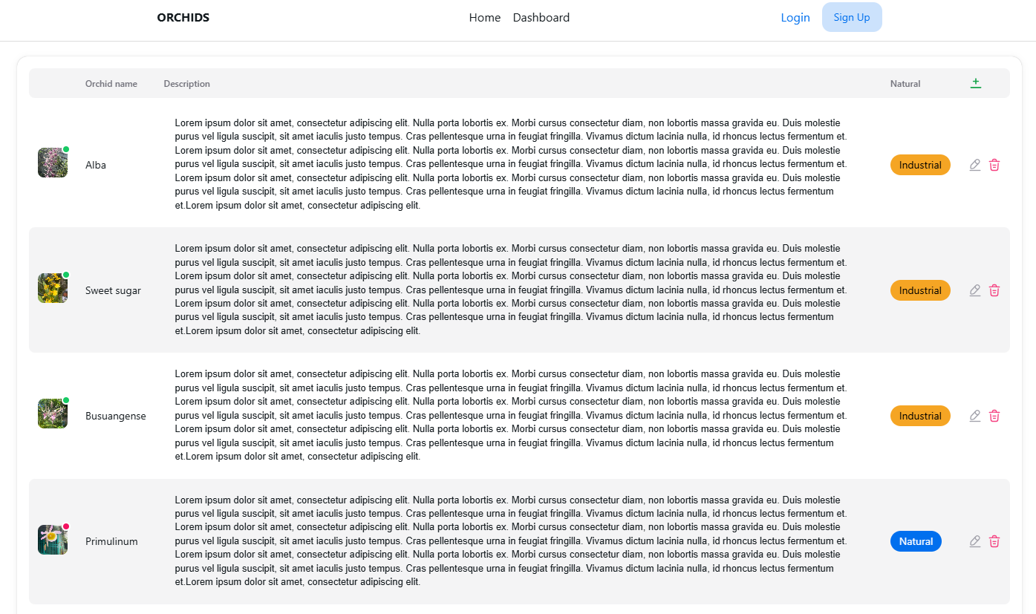
Show result

Slide 19
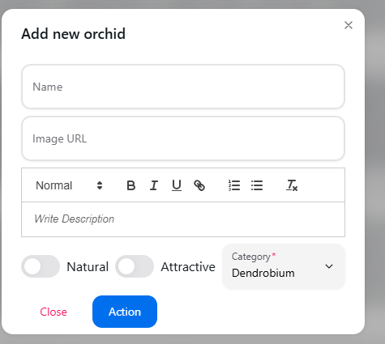
Post with AXIOS
The POST method is used to create a new resource on the server or API.
When sending a POST request, data is sent with the request and is passed to the server to create a new resource.
const onSubmit = async (data) => {
try {
const response = await axios.post(baseUrl, data, {
headers: { 'Content-Type': 'application/json' },withCredentials: true
});
onOpenChange(false);
fetchData();
reset();
toast.success("Orchid added successfully!");
} catch (error) {
console.log(error.message);
toast.error("Orchid added fail!");
}
};

Slide 20
Put with AXIOS
import React from 'react';
import axios from 'axios';
export default function Edit() {
const [api, setAPI] = React.useState({});
const baseUrl = import.meta.env.VITE_API_URL;
React.useEffect(() => {
fetchData();
}, []) React.useEffect(() => {
if (api) {
setValue('orchidName', api.orchidName);
setValue('image', api.image);
setValue('description', api.description);
setValue('isNatural', api.isNatural);
setValue('isAttractive', api.isAttractive);
setValue('category', api.category);
}
}, [api, setValue]);
const fetchData = () => {
axios
.get(`${baseUrl}/${id}`)
.then((response) => {
setAPI(response.data);
})
.catch((error) =>
console.error('Error fetching data:', error)
);
};
const onSubmit = (data) => {
axios
.put(`${baseUrl}/${id}`, data, {
headers: {
'Content-Type': 'application/json',
},
})
.then(() =>
console.log('Orchid edited successfully!');
)
.catch((error) => {
console.error(error)
});
};
The PUT method is used to update a resource that already exists on the server or API.
When sending a PUT request, data is sent with the request and is passed to the server to update the information of the existing resource.

Slide 21
Delete with AXIOS
The DELETE method is used to delete a resource that already exists on the server or API.
When sending a DELETE request, a request is sent to the server to delete the specified resource.
const handleDelete = async (id) => {
try {
const response = await axios.delete(`${baseUrl}/${id}`, {
headers: { 'Content-Type': 'application/json' },
withCredentials: true
});
fetchData();
toast.success("Orchid deleted successfully!");
} catch (error) {
console.log(error.message);
toast.error("Orchid deleted failed!");
}
};

Slide 22
Fetch vs. Axios: Comparison
Feature | Fetch | Axios
Built-in | Yes (browser-native) | No (requires installation)
JSON Parsing | Manual (response.json()) | Automatic (response.data)
Error Handling | Network errors only | Network + HTTP errors
Request Cancellation | Via AbortController | Built-in CancelToken
Interceptors | Not supported | Supported (e.g., for auth)
Size | Lightweight | Larger (third-party library
Use case | Simple apps, no dependencies | Complex apps, advanced features

Slide 23
Summary
Concepts were introduced:
Overview of Asynchronous Operations in ReactJS
Promise and Async/Await
Introduction to Fetch/Axios
Using Promise, Fetch, and Axios in ReactJS

